Slide 1


Slide 2
Attention-Deficit / Hyperactivity Disorder
in Nigerian Children and Adolescents
Presented by: Kayode Adeyemo
Last updated: August 5th, 2023

Slide 3
TOOLS ENGAGED
Python (Data Cleaning and Wrangling).
Microsoft Power BI (Data Exploration and Visualization).
Microsoft PowerPoint (Data Presentation).

Slide 4
Goals for our discussion today:
1
2
3
Share an overview of Attention-Deficit / Hyperactivity Disorder.
We will begin with a global overview of ADHD in children and adolescents, and narrow our focus to data on the prevalence of ADHD in Nigerian children and adolescents.
Examine trends of ADHD in Nigerian children and adolescents using historical data.
Understanding the trends of prevalence and which age group has more prevalent cases, this can help us to be better prepared to spot and handle the effects of ADHD in our children and adolescents.
Discuss any potential area for further exploration.
While there are many different next steps we want to focus on the ones that are most important in our community.

Slide 5
BACKGROUND INFORMATION
Attention Deficit Hyperactivity Disorder (ADHD) is a neurodevelopmental disorder, it is a condition that affects the ability to focus, control impulses, and regulate behavior.
ADHD is often diagnosed in childhood, but it can also affect adults.
Approximately 129 million children and adolescents worldwide between the ages of 5 to 19 years old have ADHD.
Impact on Daily Life
Children with ADHD are more likely to struggle in school and have difficulty making and keeping friends.
Adults with ADHD may have difficulty with time management, organization, and completing tasks.
People with ADHD are more likely to struggle with addiction, anxiety, and depression.
It is important to note:
ADHD is not caused by bad parenting or lack of discipline.
People with ADHD can succeed in school, work, and relationships with the right support and treatment.

Slide 6
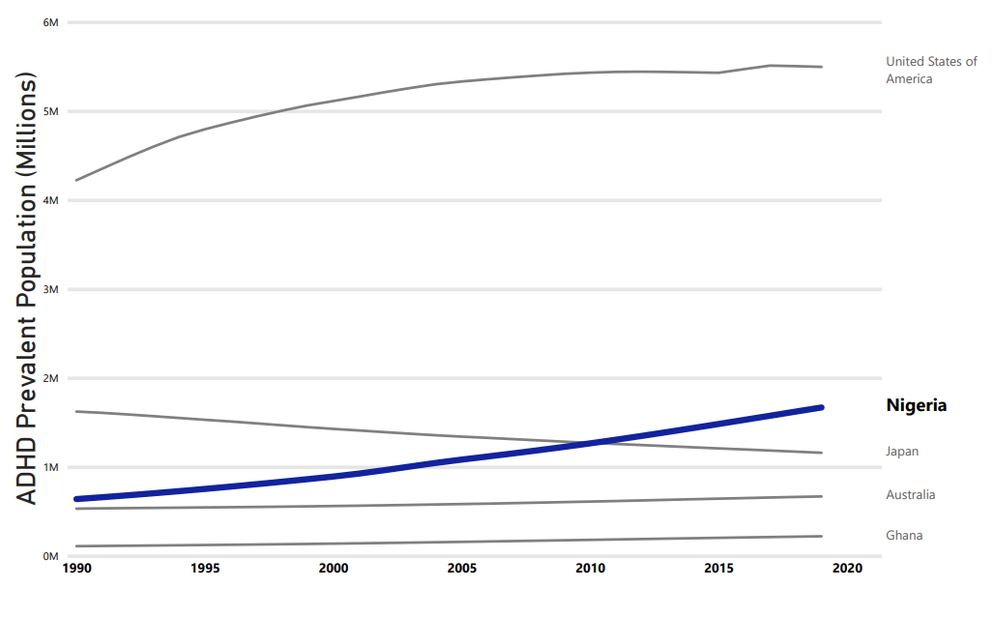
There has been an increase in the number of prevalent cases of ADHD in Nigeria from 1990 to 2019.
The trend of prevalent cases of ADHD
Data overview
Our data shows prevalent ADHD cases from 1990 to 2019.
Data on a selected few are shown to assess Nigeria's prevalent cases in relation to other countries.
The prevalence of cases is in the millions.

Slide 7
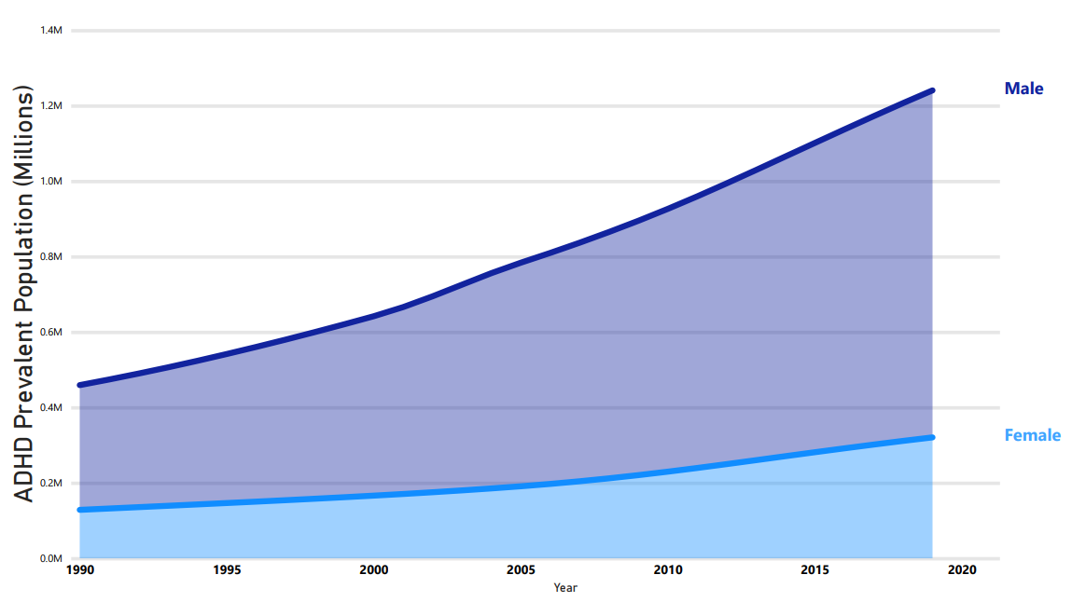
Males are nearly four times more likely to exhibit ADHD than girls based on a gender comparison of cases among Nigerian children and adolescents.
Gender comparison of cases among Nigerian children and adolescents
Key takeaways:
The rate of ADHD prevalence in male children was nearly fourfold that in girls (1.25 per million and 0.35 per million respectively) as of 2019.

Slide 8
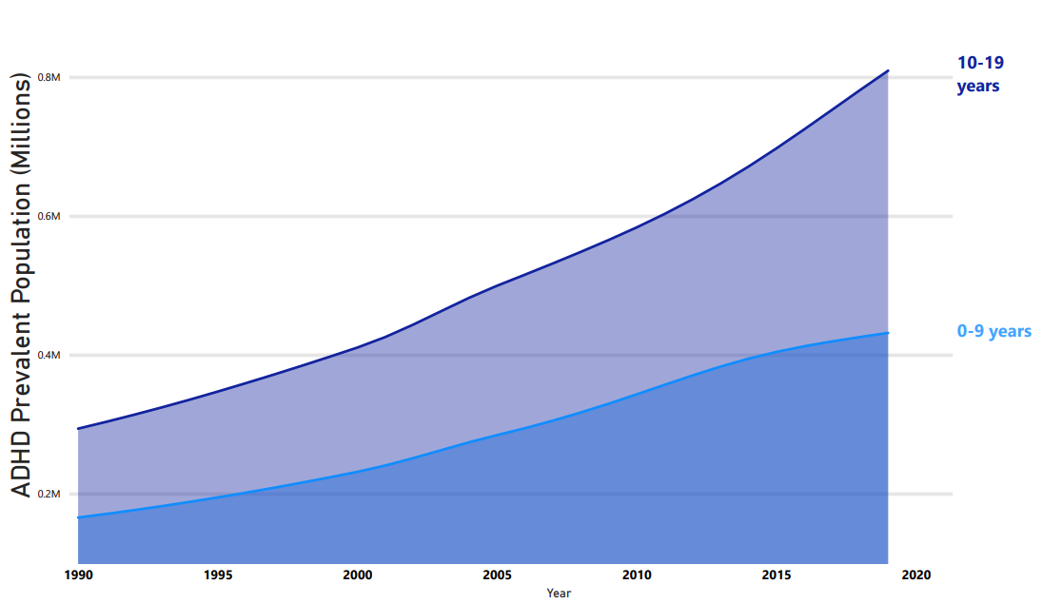
Adolescents are nearly twice more likely to exhibit ADHD than children based on a age comparison.
Age group comparison of cases among Nigerian children and adolescents
Key takeaways:
Prevalent cases in adolescents were nearly twice that in children (0.82 per million and 0.44 per million respectively) as of 2019.

Slide 9
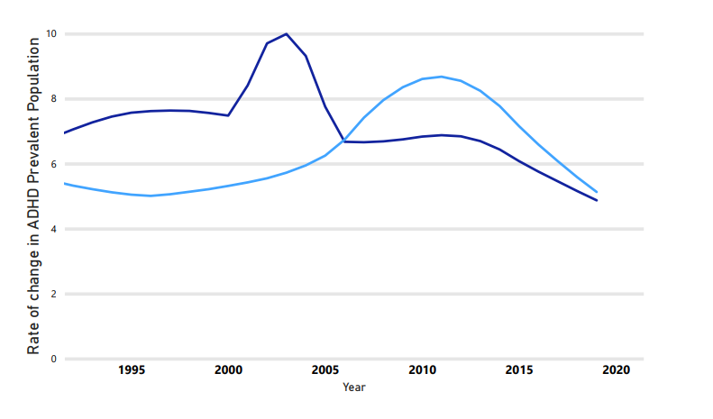
There was a consistent decline in the number of new cases of ADHD among both males and females.
Rate of development in both male and female ADHD cases among Nigerian children and adolescents.
Key takeaways:
There was a consistent fall in the rate of development in both the male and female ADHD cases from 2003 to 2019 and 2011 to 2019.
Male
Female

Slide 10
Possible further exploration
“Adolescent Boys are more likely to be diagnosed because of behavior difficulties, whereas girls are often overlooked because their symptoms may present differently. Therefore, it is important to educate teachers and parents on what to look for with regards to ADHD in children, such as daydreaming, interrupting conversations, impulsive behaviors, talking too much in class and becoming easily frustrated,” says Julie Angileri, a double board-certified psychiatric mental health and family nurse practitioner with Capstone Mental Health in Mesa, Arizona.
While it's unclear why there has been such a decline in new ADHD diagnoses, some experts speculate that it may be due to lack of awareness and understanding of the condition among healthcare providers and the general public.

Slide 11
Conclusion
ADHD is considered to be a common condition, especially among children. In fact, ADHD is one of the most commonly diagnosed neurodevelopmental disorders in childhood.
it's clear that ADHD is a significant public health concern that deserves attention and resources to ensure that those living with this condition can receive appropriate care and support early.
Understanding the statistics and facts about ADHD can help reduce stigma and increase awareness about this condition.
If you or someone you know may have ADHD, it's important to seek professional help for diagnosis and treatment. With the right support, people with ADHD can lead successful and fulfilling lives.

